Slide 1

Data Fellowship Network visualisation and analysis of government procurement policy
dta-accelerator
Presenting from: Canberra

Slide 2
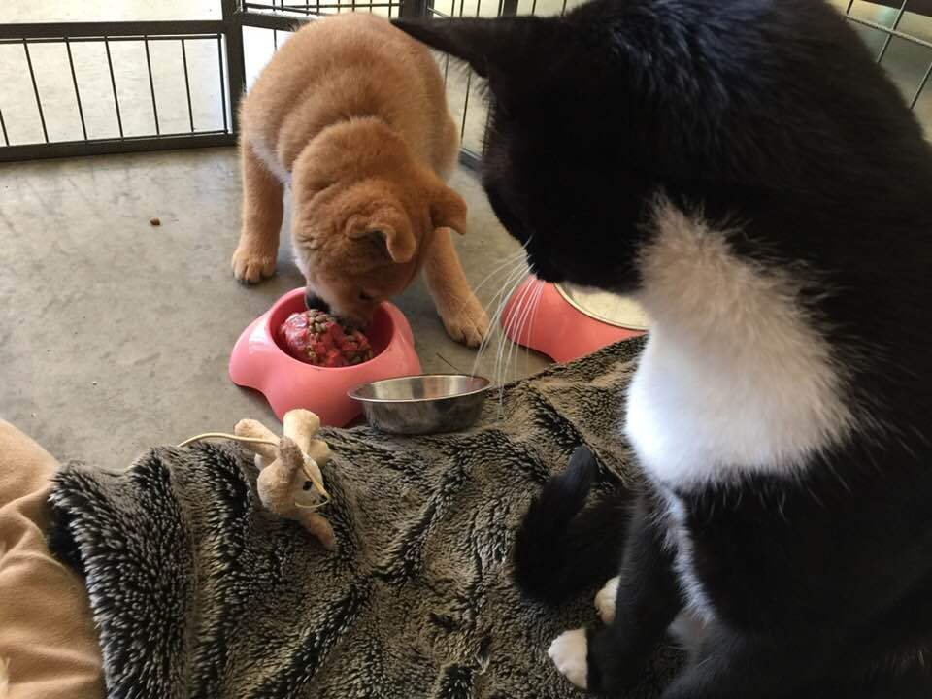
1/ Team updates
Since it is just me, here is a picture of one of my cats and my puppy

Slide 3

2/
Download and cleanse AusTender contract data from 1 January 2007 to 1 May 2018
Develop and apply machine learning algorithms to identify small/medium/large and transnational businesses
Use current text analysis techniques to group 3000 contract categories into 150 contract ‘families’
Identify ASX listed vendors and link major contract dates to a graph of their market capitalisation
Identify appropriate statistical model to evaluate the relationship between changes in government policy and procurement decisions
Sprint goals

Slide 4
3/ Sprint takeaways
Government could make better use of APIs to automate data entry and improve overall data quality

Slide 5
3/ Sprint takeaways
Machine learning and text analysis is applicable to DTA datasets and rapidly provides policy insights

Slide 6
3/ Sprint takeaways
Time series analysis and visualisation of human networks is not as easy as I thought it would be.

Slide 7
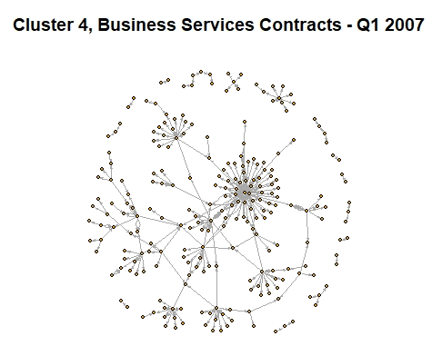
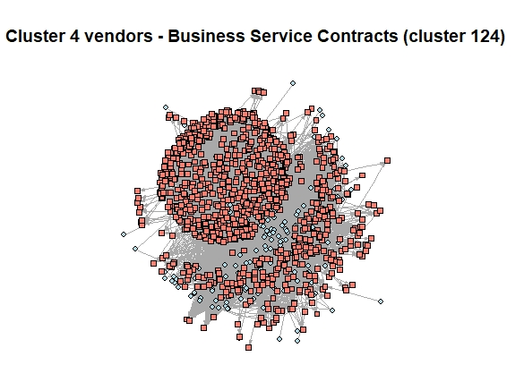
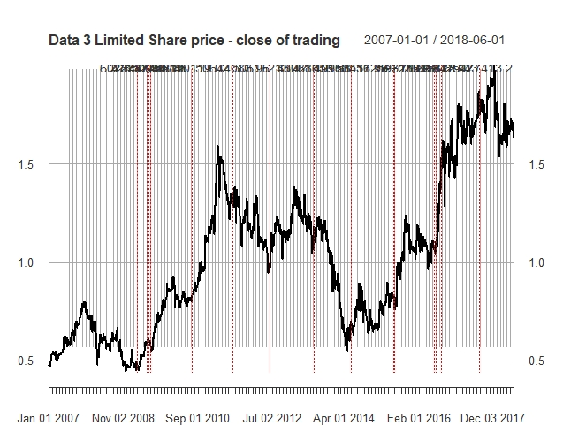
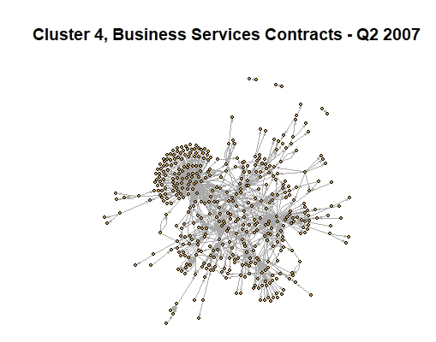
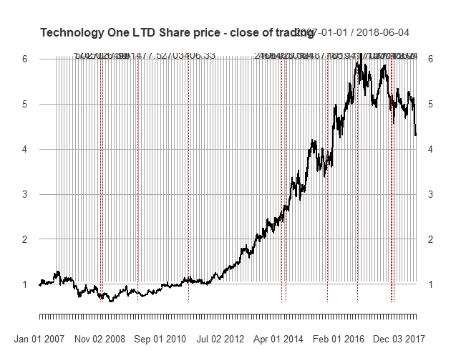
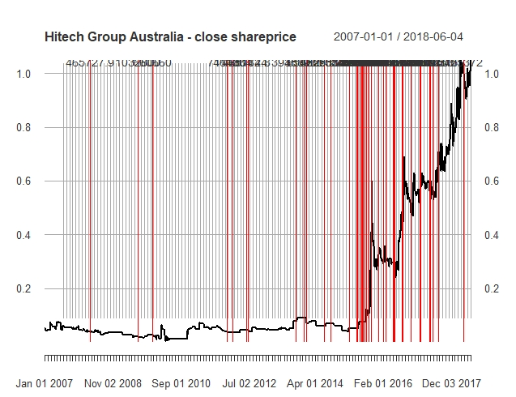
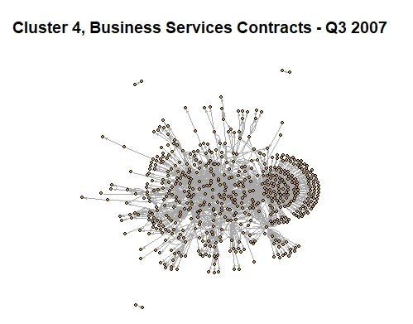
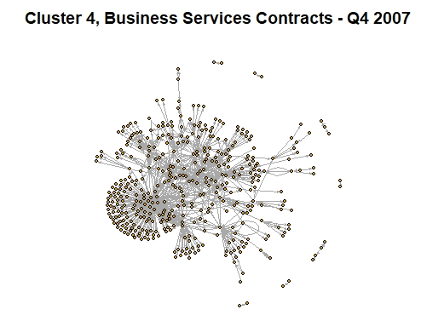
4/ Show the thing
Notes:
Link

Slide 8
Thank you

